Slide 1

REAL ESTATE
Sprint 1&2

Slide 2
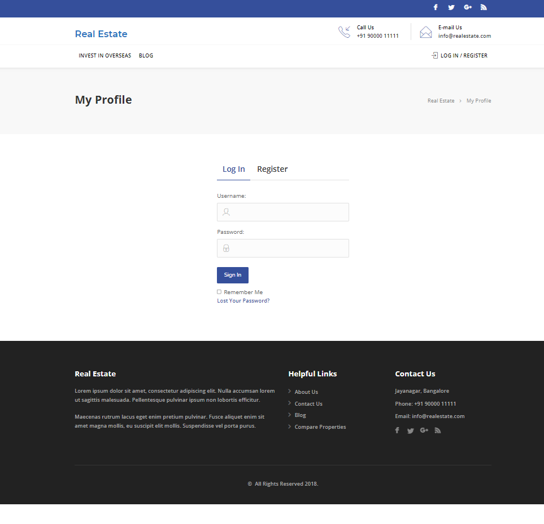
Real Estate website
Welcome to Real Estate

Slide 3
FEATURES
Admin
Login
Profile
Dashboard
Comments
user-all, new, profile
Post-all post
Media-library, add new
property-add new
User
Register/Login
Homepage
Profile
Property management-contact form
Search property
Bookmark
For enquires
Change password

Slide 4
Manual testing - sprint 1
Activities
Planning-User stories in Jira
Work allocation- For test design to team members- Jira tasks
Test design process-
Scenarios- categorised based on business risks
Test cases
Pre-conditions and specification for data creation
Test design techniques applied where ever necessary
Review process and baseline of testcases

Slide 5
Jira – Workflow in Sprint 1
3 Stories were created in Jira with respect to Admin side and user side
No of tasks & sub-tasks-4
No of bugs - 1
Review of each task was completed.
Execution of the testcase was submitted.
Defects were logged into the defect log with 1 defects.
Issue log was created with 11 issues.

Slide 6
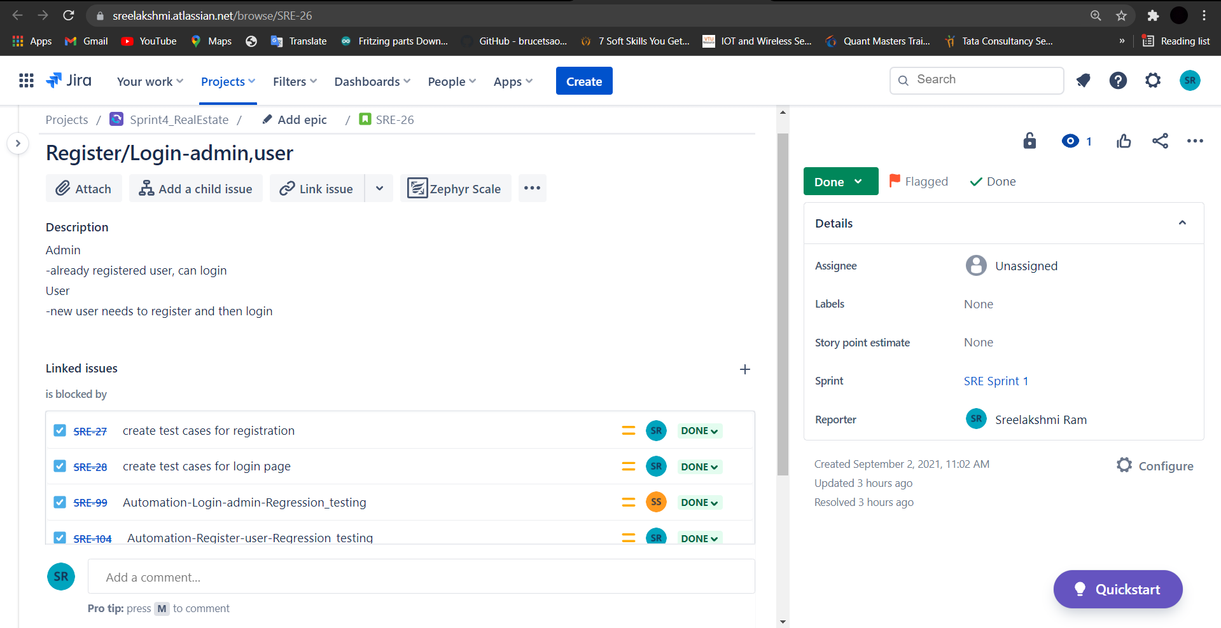
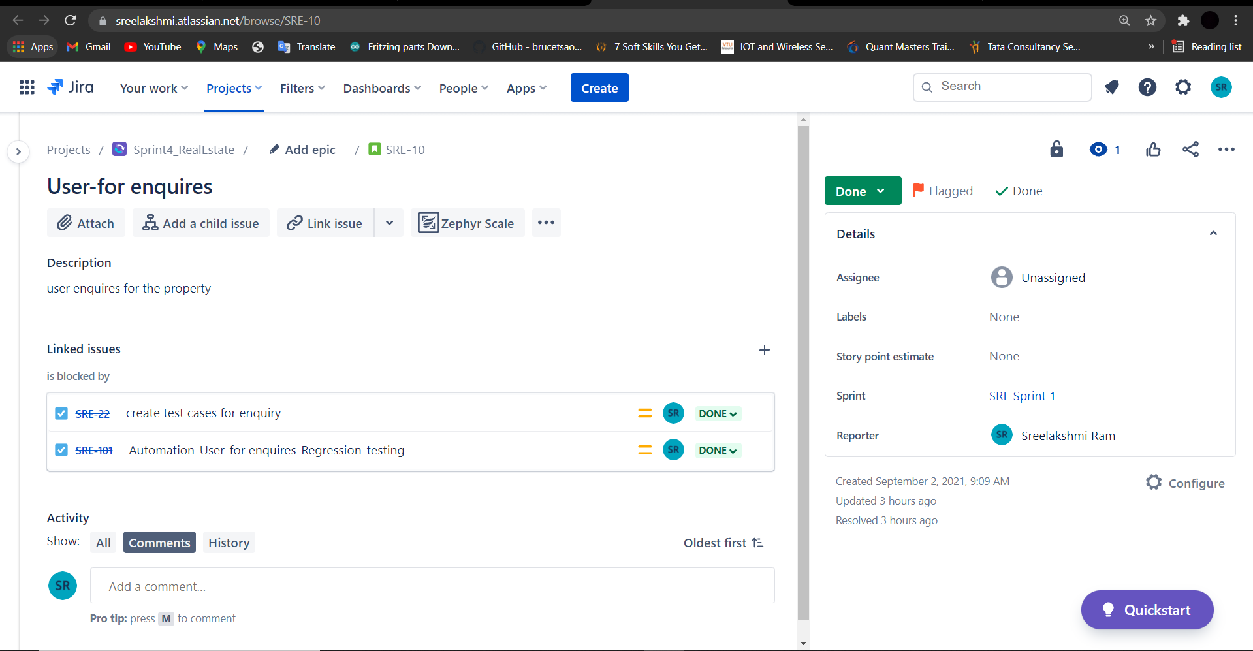
Real Estate website
Stories
Register User, Login admin/user
Enquiry Page

Slide 7
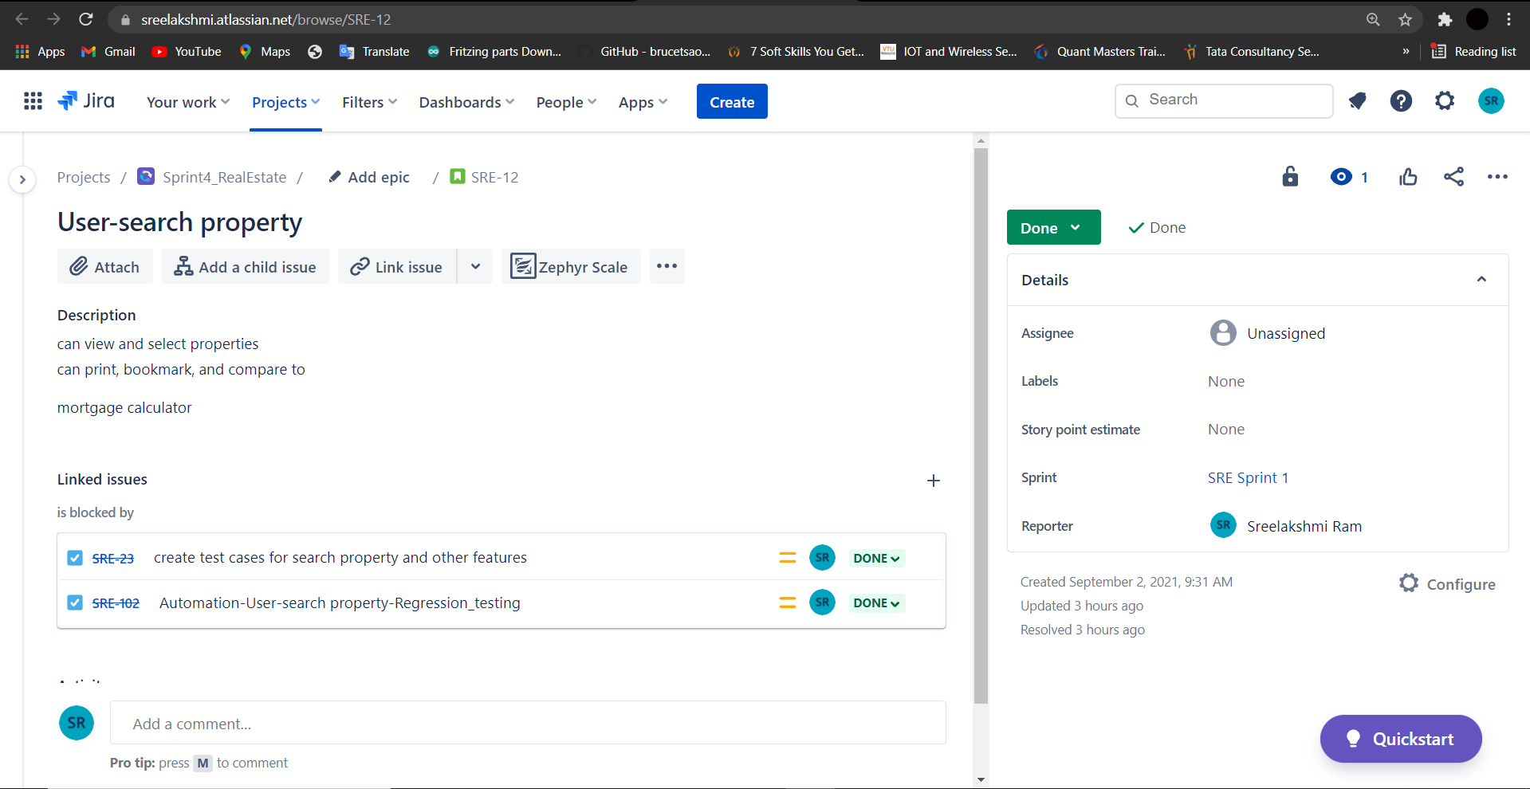
Real Estate website
Stories
Search property

Slide 8
Sprint 1 - Workflow
From user perspective register new user and login functionalities was assigned by scrum master.
Along with that after login, search functionality with bookmark feature and enquiry form was also assigned.
Stories and task for the above functionalities were created in Jira.
Test cases were created in excel.
Test cases were reviewed and checklist were sent back.
Defects and issues which were found during the execution of test cases and were noted down.
Bugs were created in Jira.

Slide 9
Test execution
Preparation of test data
Smoke test including pre-condition check
Start of Test execution
Defect logging if any –2 cycles
Follow ups
Bug allocation to development team
Updating of issue log

Slide 10
Test Metrics
Module wise number Of test cases written-29
Category wise defect analysis based on priority, severity, status -1
Review of each task and submission of checklist.
Execution of the testcase was submitted.

Slide 11
Post execution activities
Like to have features in application communicated to developers.
Ongoing issues discussed during the pre-production move of release 1.
Review of acceptance criteria.
Planning for regression test cases using manual/automation approach.

Slide 12
Automation testing - Sprint 2
Planning activities-selection of test cases for automation under
Smoke test
Sanity test
Regression test
Task allocation for automation test cases to automation testers
Techniques followed - Selenium , Java ,Maven, TestNG, Page Object Model, frameworks selected for the automation

Slide 13
Jira – Workflow in Sprint 2
3 Stories were created in Jira with respect to Admin side and user side
Sprint 1 -
No of tasks & sub-tasks-6
No of bugs – 2
Each task went through different automation testing which was segregated with respect to severity.
Defects were logged into the defect log with 2 defects.
Issue log was created with 4 issues.

Slide 14
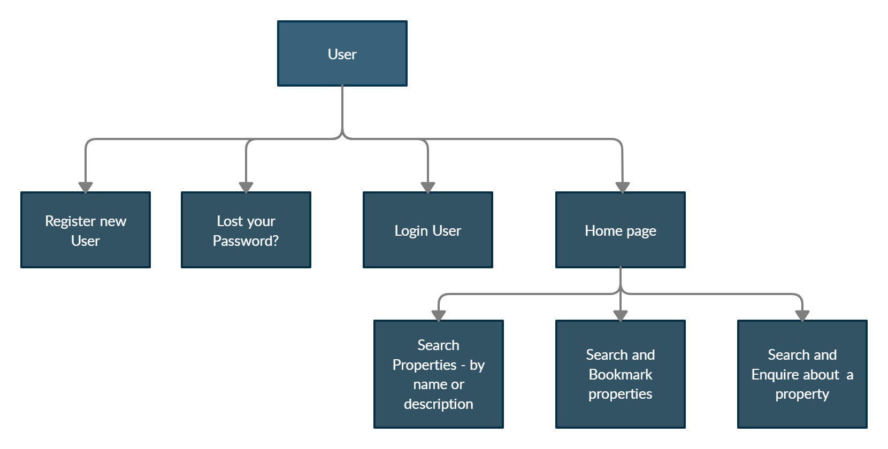
Sprint 2
USER
1. Sanity Test –User Bookmark properties
2. Regression Test - Register user, Login user, Lost password, User Search, Enquire property
Automation of for the above functionalities were done using eclipse.
Selenium , Java ,Maven, TestNG, Page Object Model, frameworks were selected for the automation.
Screenshots of non-functional commands were taken and defects were noted down.
TestNG reports were generated.

Slide 15
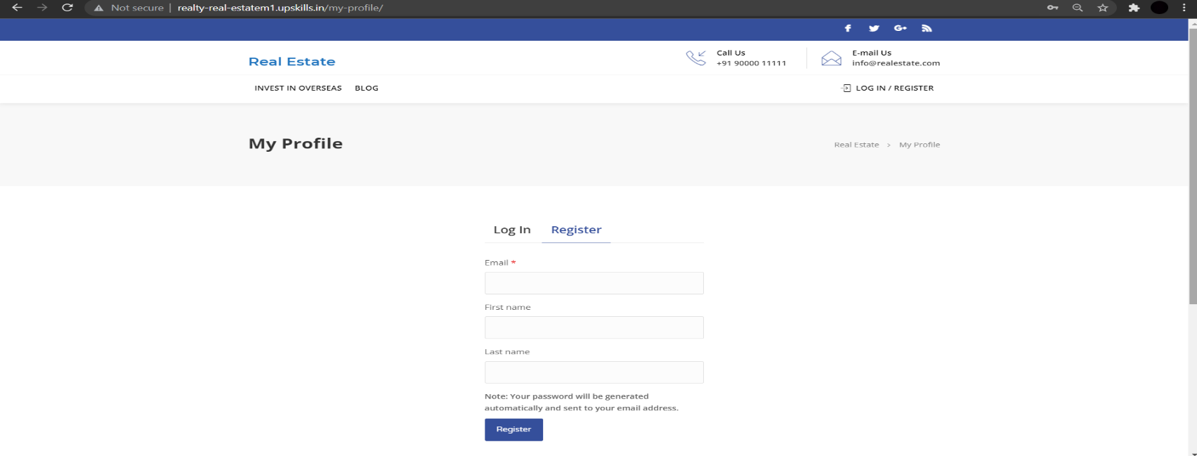
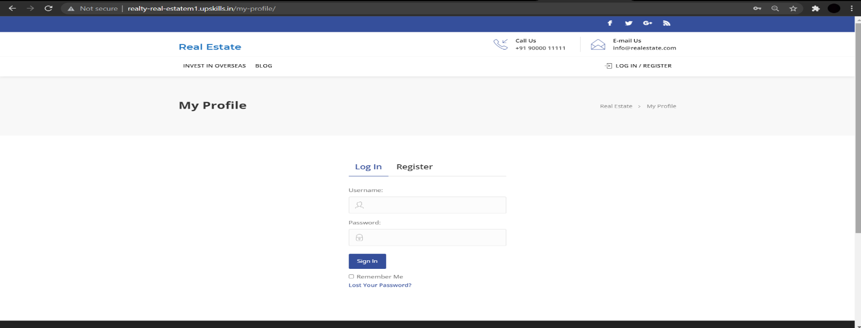
Real Estate website
Register User, Login user with Lost password

Slide 16
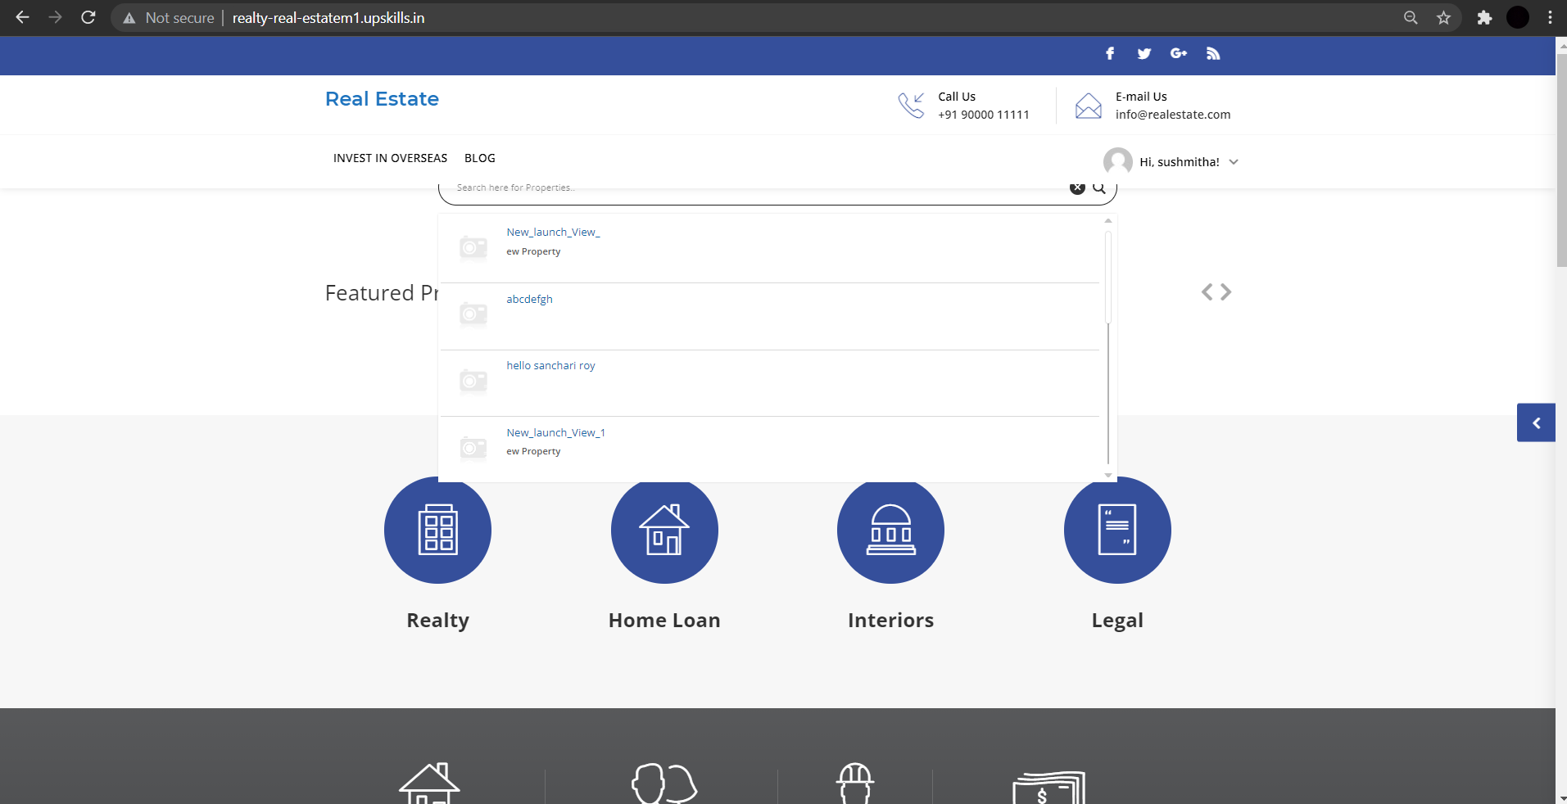
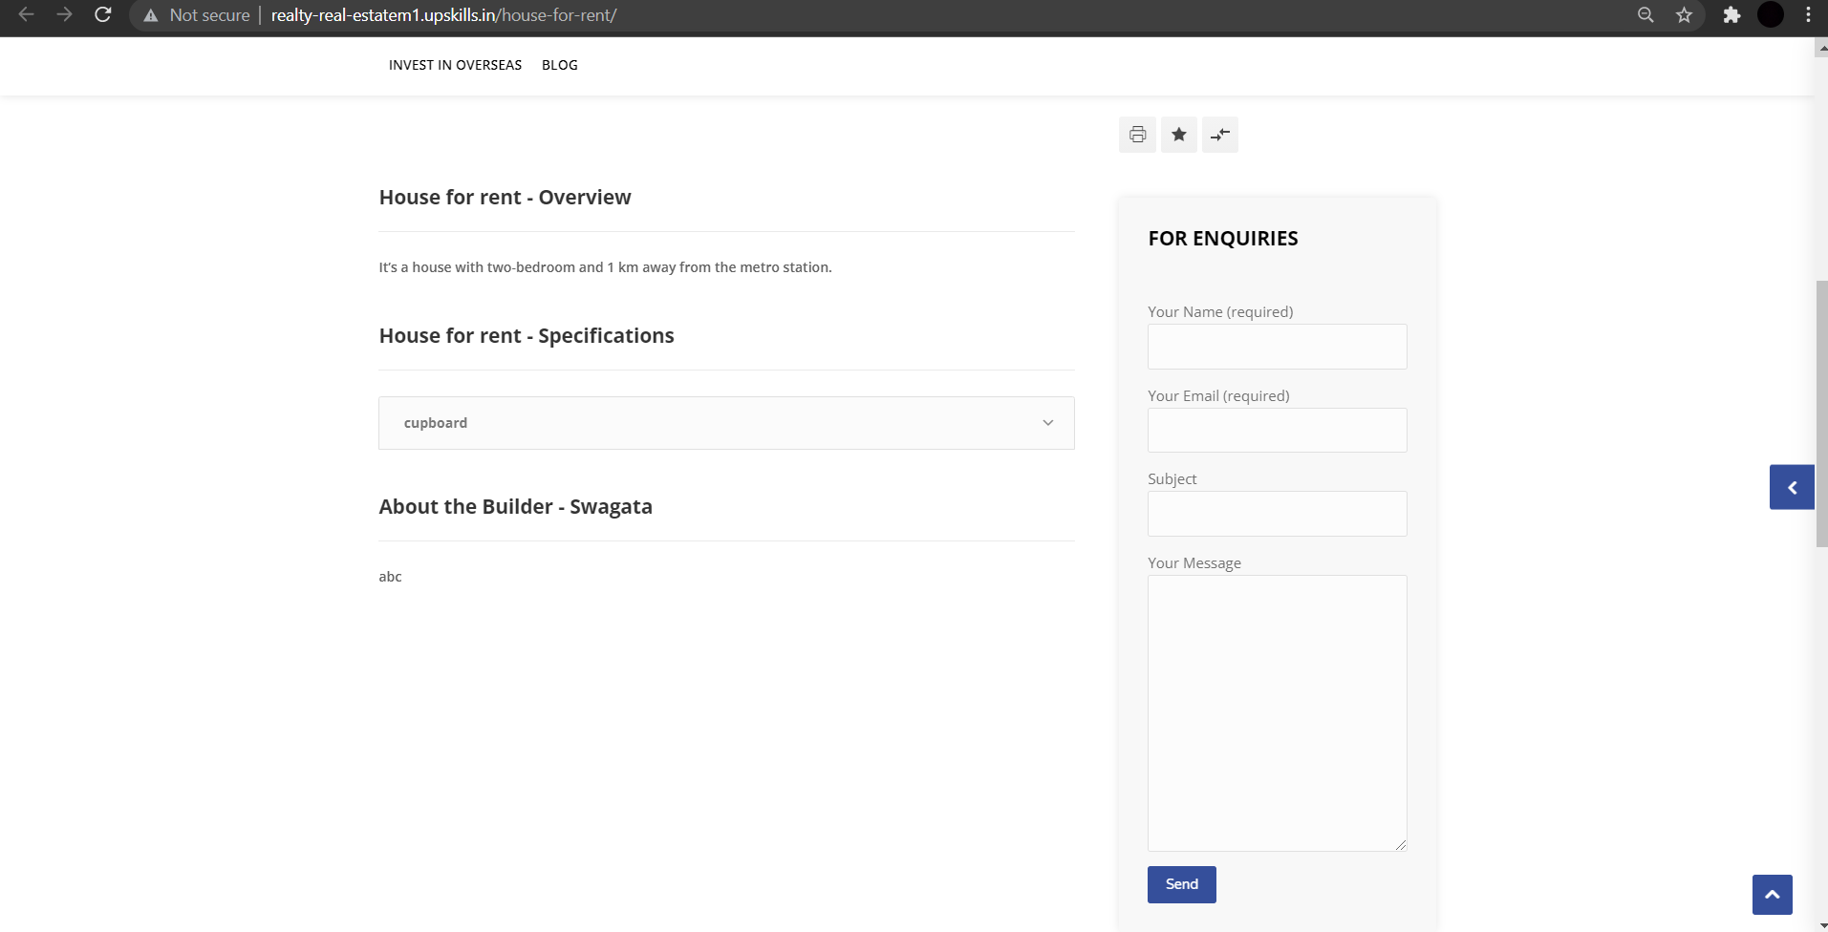
Real Estate website
Search properties with Bookmark and Enquiry form

Slide 17
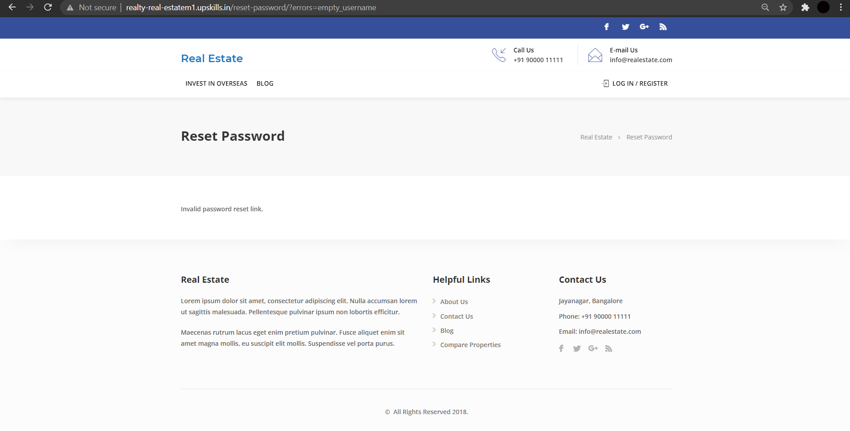
Screenshots
Of Non-functional Commands
-Lost password
Real Estate website

Slide 18
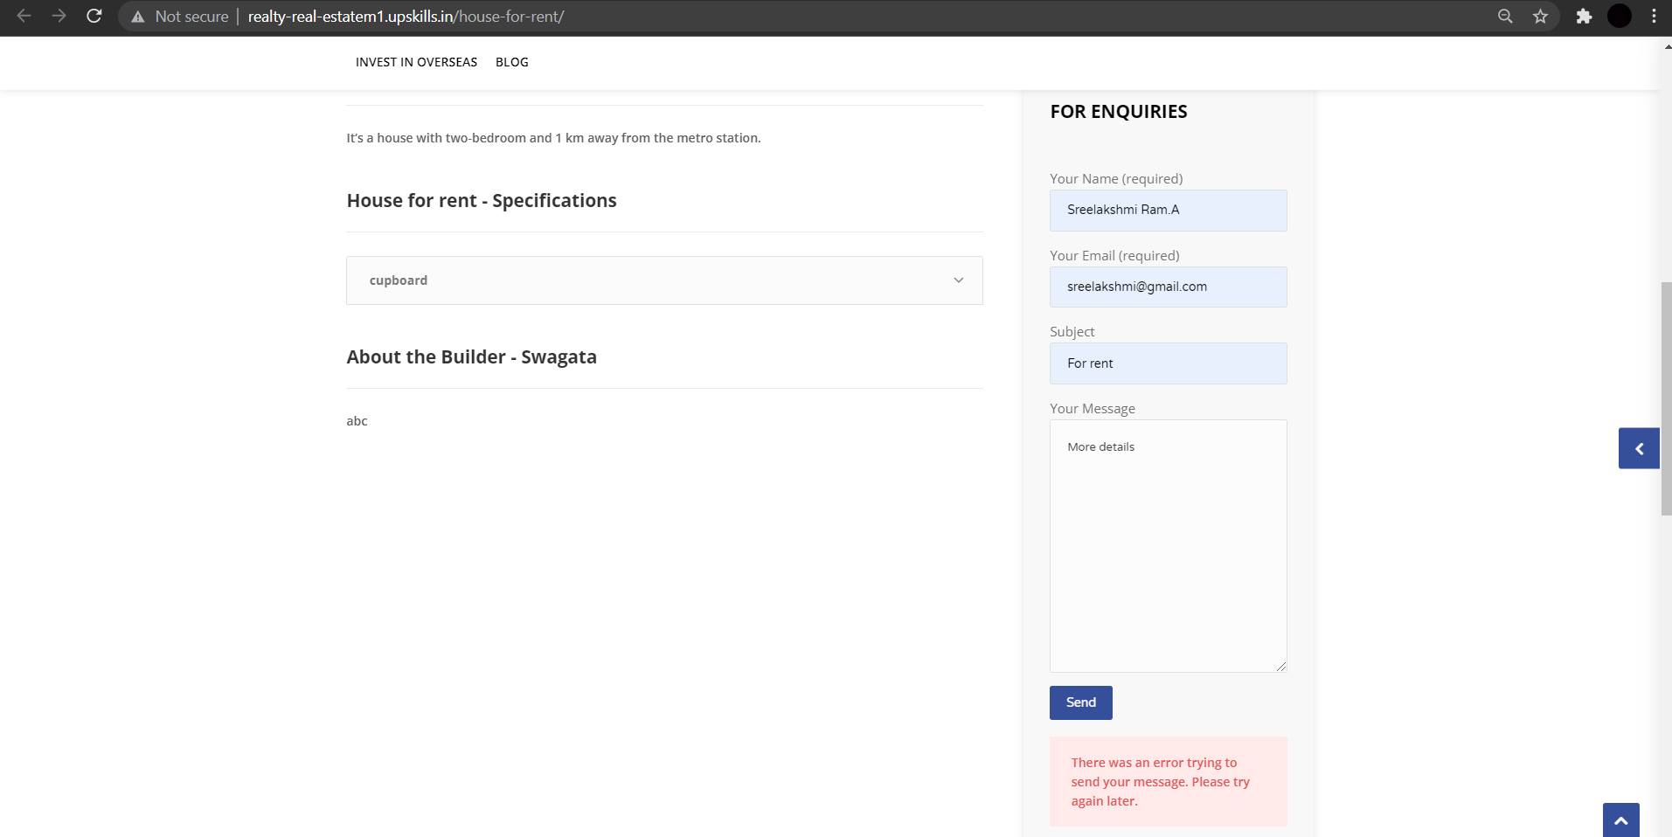
Screenshots
Of Non-functional Commands
-Enquiry form
Real Estate website

Slide 19
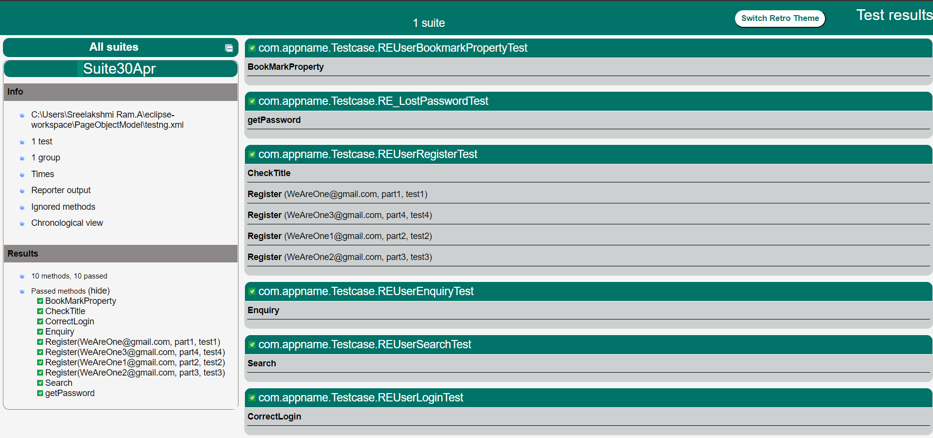
TestNG report

Slide 20
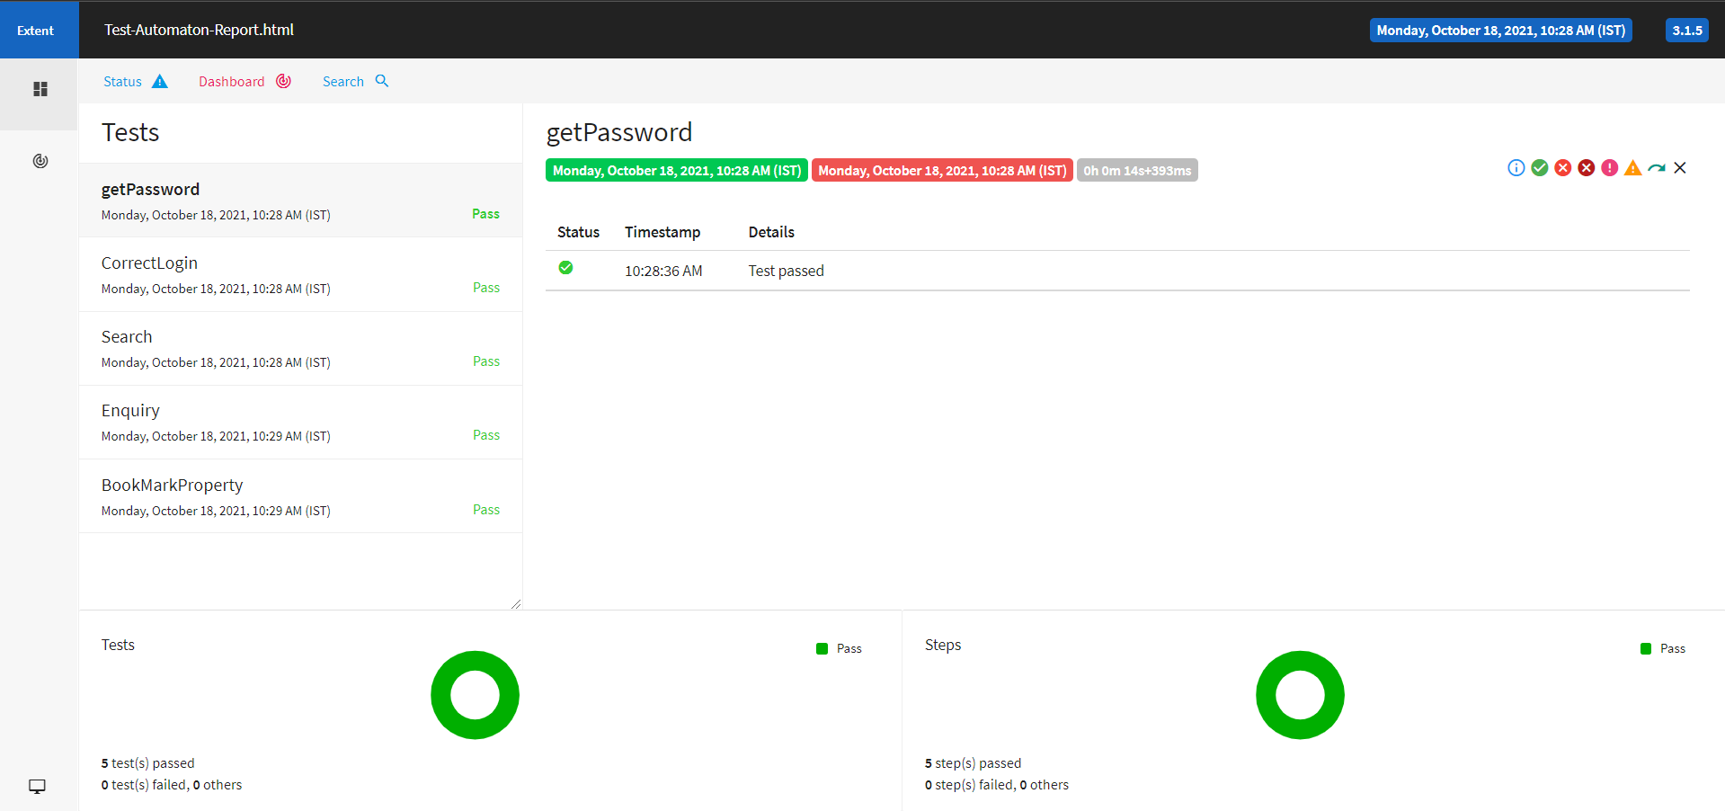
Extent report

Slide 21


